Slide 1
Analyzing Variation in Peak Snow Water Equivalent (SWE) Across EPA Ecoregions in the Conterminous U.S. in Water Year 2023
Griffin Shelor
Advisor: Dr. Anne Nolin

Slide 2
Workflow
Download/Project SNOTEL and Ecoregion data
Download/Mosaic DEM
Test for clustering and spatial autocorrelation
IDW
Extract IDW values to Ecoregions
CAR
Scream into Void

Slide 3

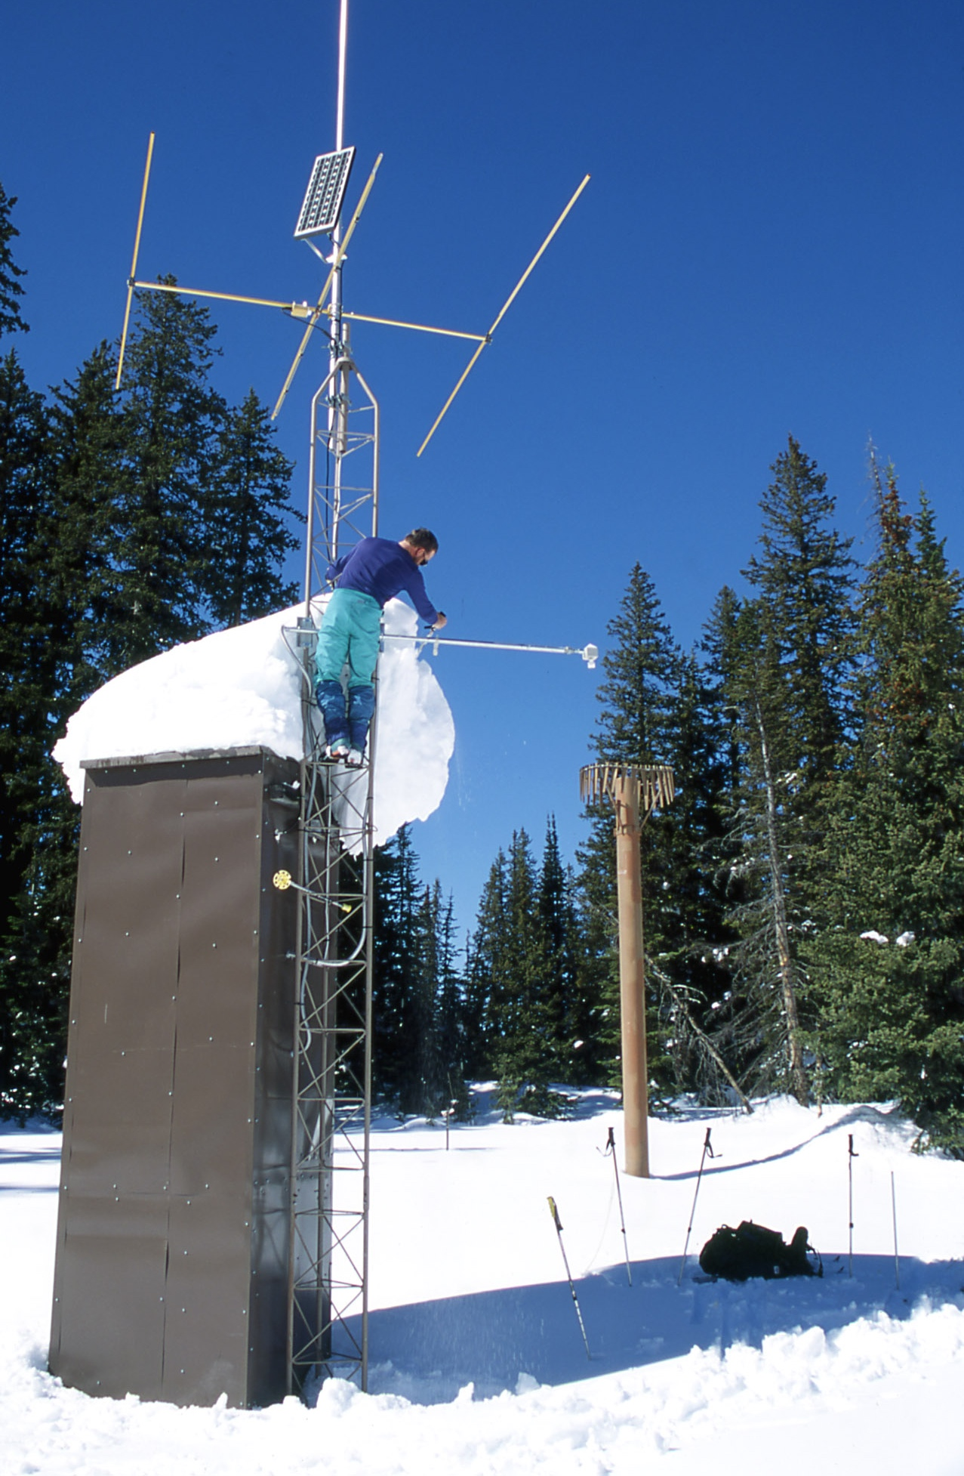
So What is SNOTEL and SWE?
System of automated snow and climate sensors
Managed by USDA-NRCS
Snow Water Equivalent
Amount of water contained within the snowpack
snotelr package

Slide 4
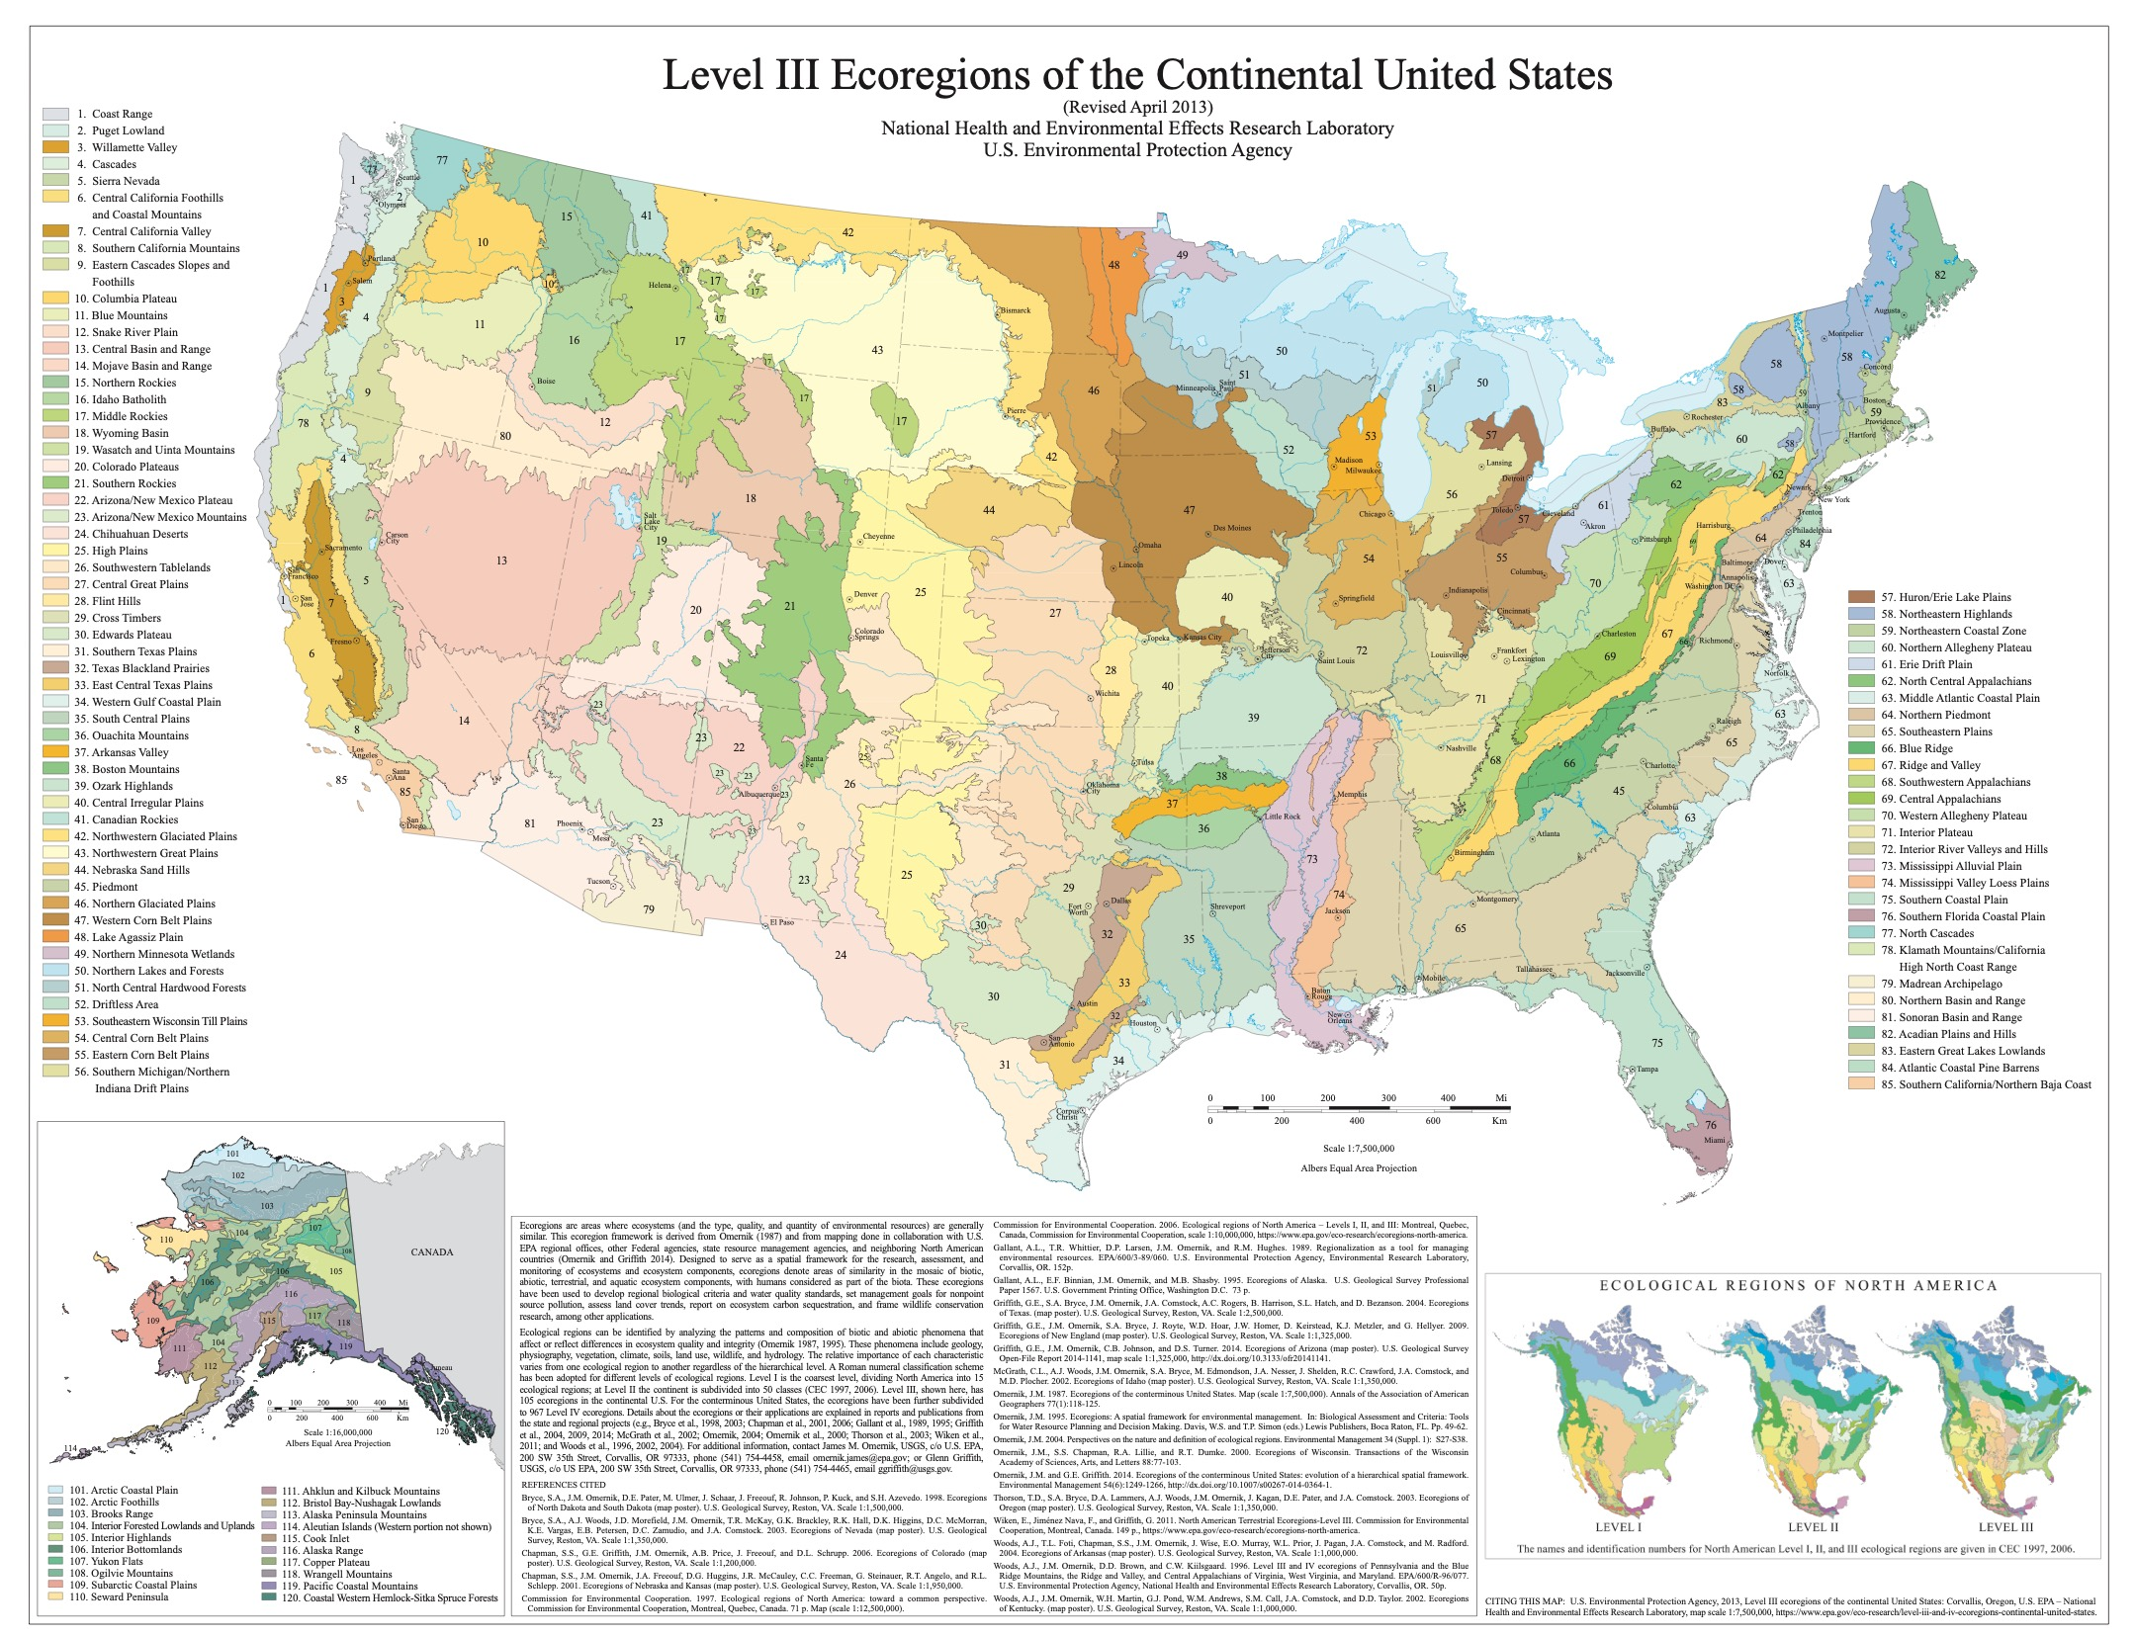
Other Data Sources
EPA Level 3 Ecoregions
Based on a variety of abiotic and biotic factors
Copernicus 90m DEM
rstac/MPC API

Slide 5
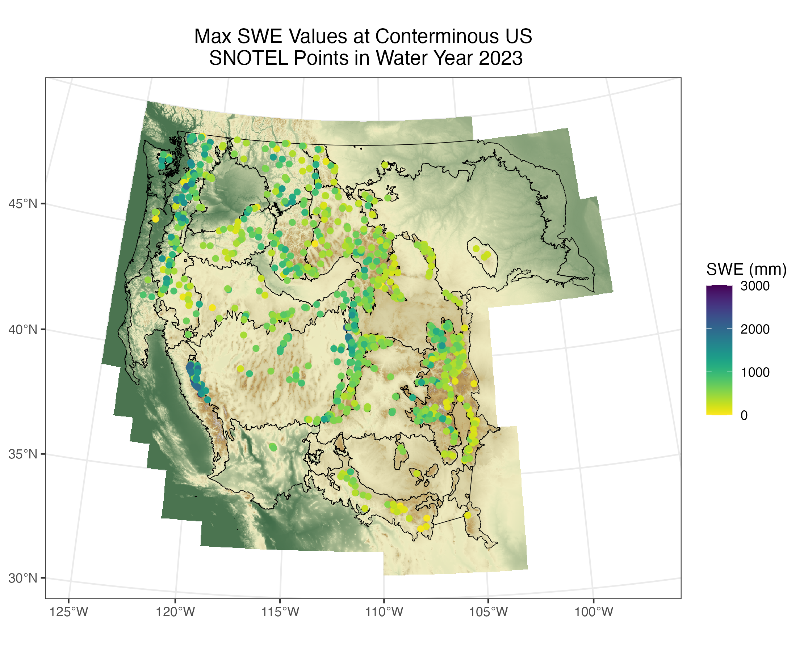
Plotting SWE

Slide 6
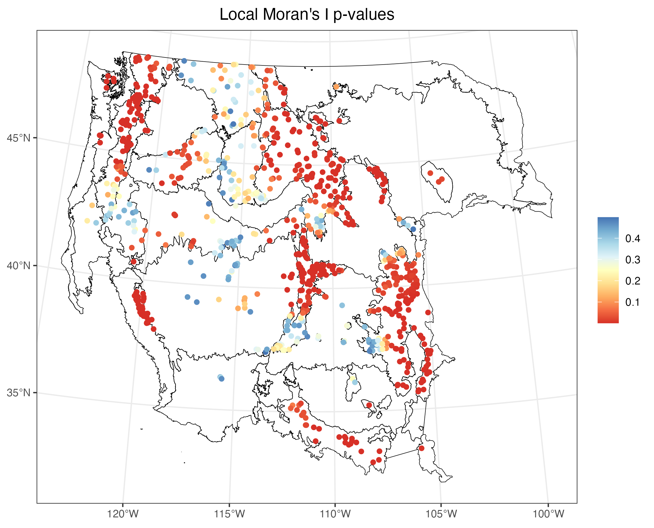
CSR and Spatial Autocorrelation
Mad Test p-value: 0.003984
global and Local Moran’s I test on SNOTEL points
Global P-value: <2.2e^-16
Local: 65.5% of points displayed local SA

Slide 7
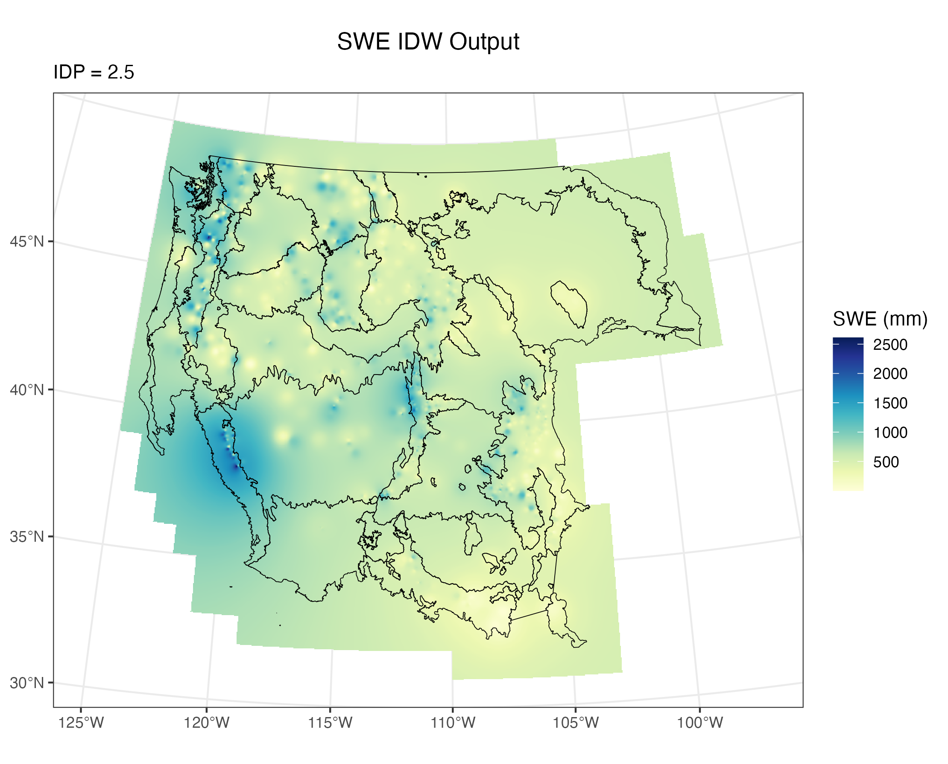
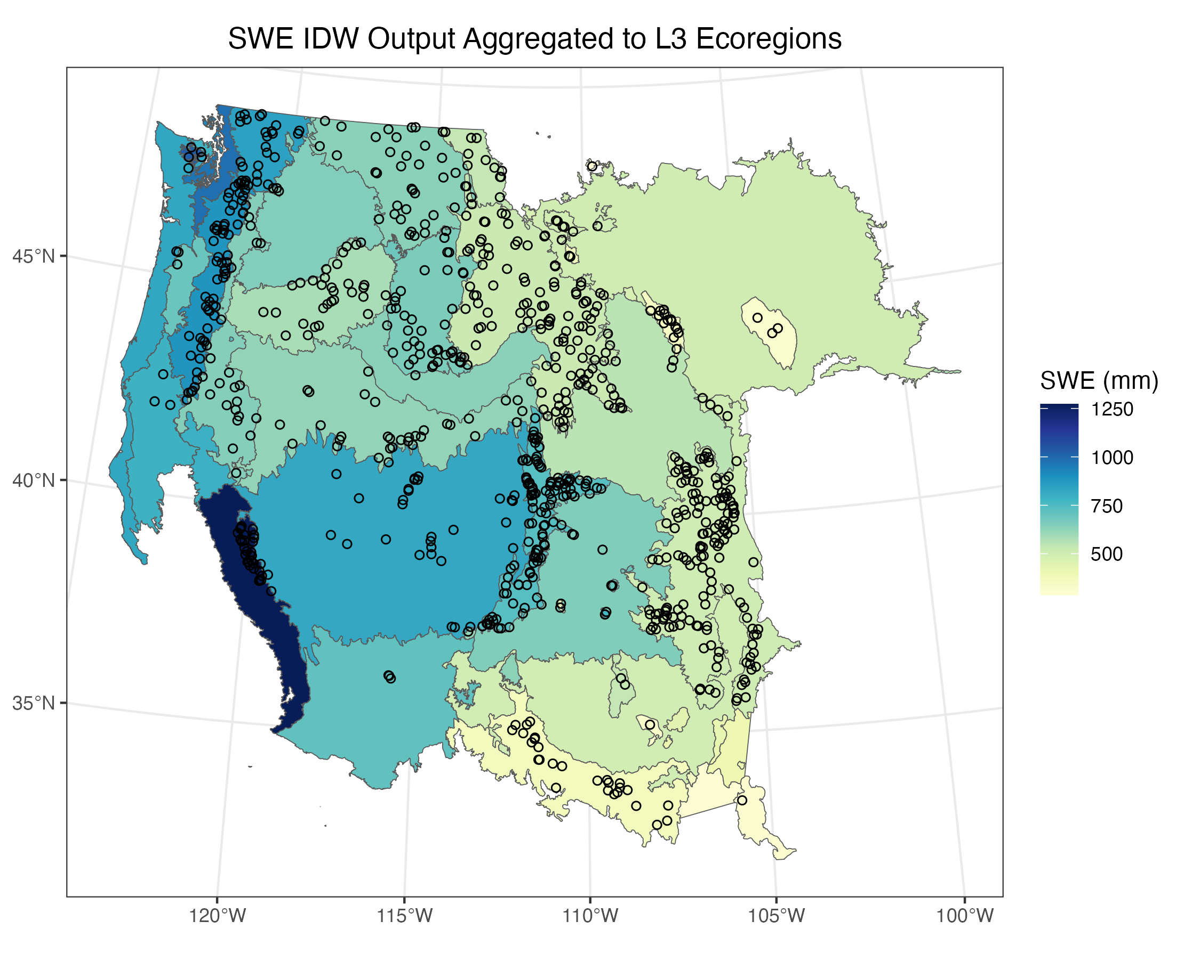
IDW and Aggregation to Ecoregion Level

Slide 8
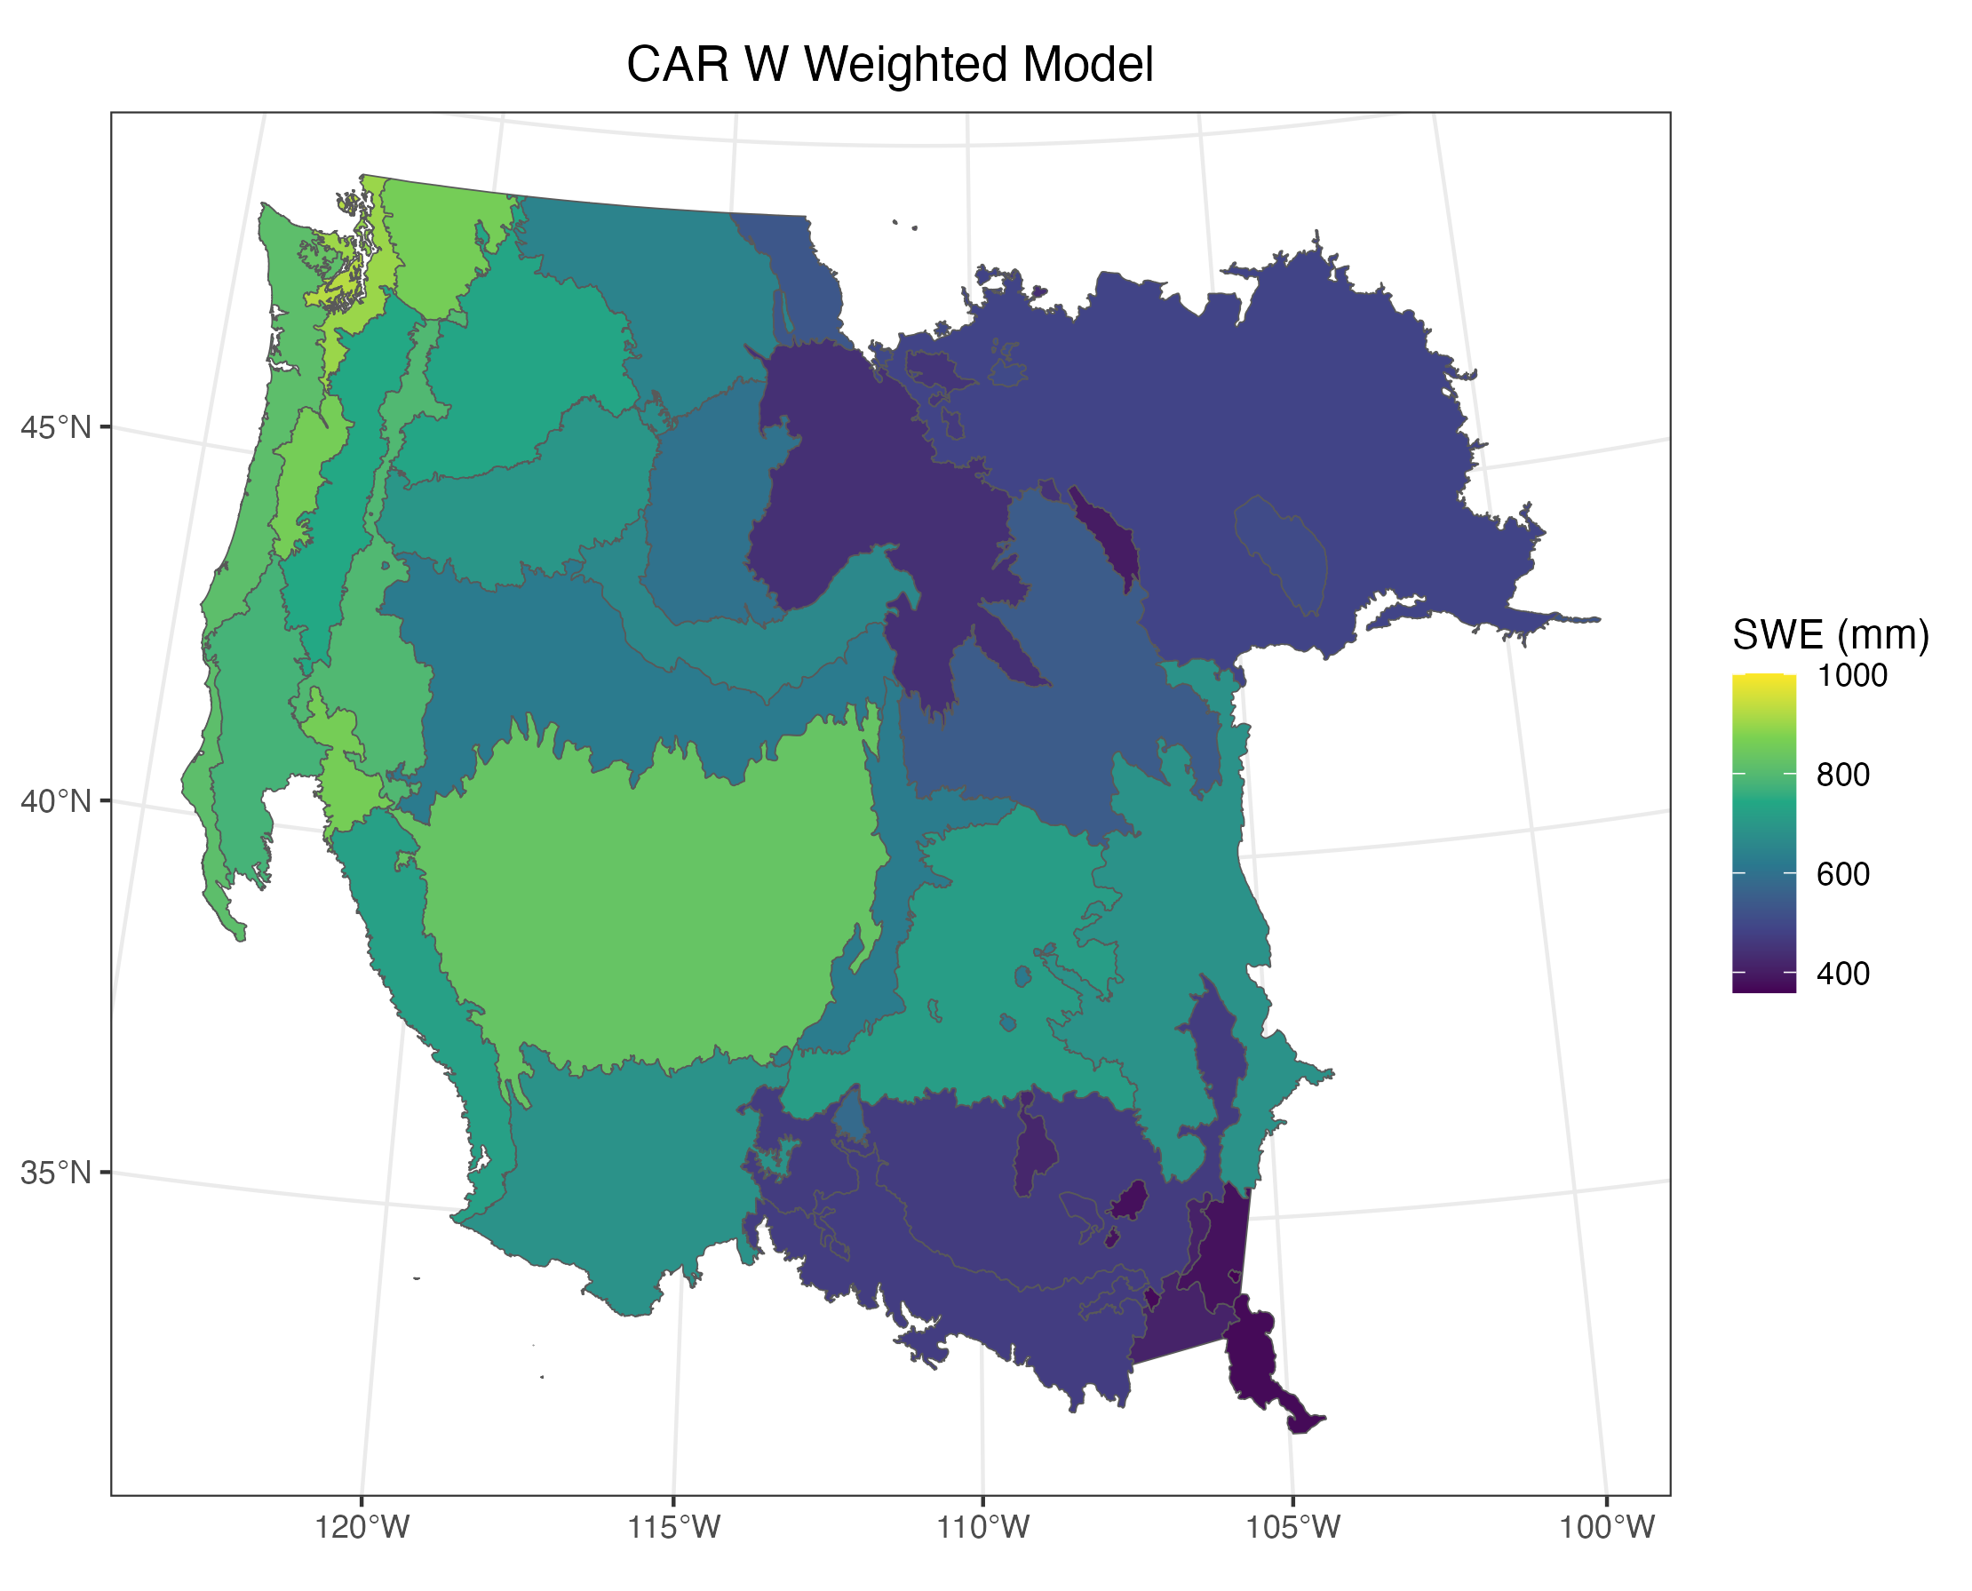
CAR Model
Moran’s I test at Ecoregion level: p-value = 0.000999

Slide 9
References
Hufkens, K. (2022). snotelr: a toolbox to facilitate easy SNOTEL data exploration and downloads in R. Zenodo. https://doi.org/10.5281/zenodo.7012728.
Vafakhah, M. Spatiotemporal Variability of Snow Depth, Density, and Water Equivalent across Iran. Russ. Meteorol. Hydrol. 43, 118–126 (2018). https://doi.org/10.3103/S1068373918020073
Taheri, M., & Mohammadian, A. (2022). An Overview of Snow Water Equivalent: Methods, Challenges, and Future Outlook. Sustainability, 14(18), 11395. https://doi.org/10.3390/su141811395
Omernik, J.M., Griffith, G.E. Ecoregions of the Conterminous United States: Evolution of a Hierarchical Spatial Framework. Environmental Management 54, 1249–1266 (2014). https://doi.org/10.1007/s00267-014-0364-1

